Slide 1
Dimensionality/feature reduction, Subspace learning, Low rank representation
Huijun Di
ajon@bit.edu.cn

Slide 2
Outline
Background
Unsupervised dimensionality reduction
linear: PCA
nonlinear: GPCA, Kernel PCA, ISOMAP, LLE
Supervised dimensionality reduction
linear: LDA
nonlinear: Kernal LDA
Sparse subspace learning
Summary

Slide 3
Background
Why dimensionality reduction?
What is dimensionality reduction?
Signal representation versus classification

Slide 4
Why dimensionality reduction?
Most machine learning and data mining techniques may not be effective for high-dimensional data
Curse of Dimensionality
Accuracy and efficiency degrade rapidly as the dimension increases.

Slide 5
The curse of dimensionality
 In practice, the curse of dimensionality means that, for a given sample size, there is a maximum number of features above which the performance of our classifier will degrade rather than improve
performance
dimensionality

Slide 6
■ Exponential growth in the complexity of the target function (a density estimate) with increasing dimensionality
The curse of dimensionality
 “A function defined in high-dimensional space is likely to be much more complex than a function defined in a lower-dimensional space, and those
complications are harder to discern” –Friedman
■ This means that, in order to learn it well, a more complex target function requires denser sample points!

Slide 7
The curse of dimensionality
■ Exponential growth in the number of examples required to maintain a given sampling density
 For a density of N examples/bin and D dimensions, the total number of examples is N^{D}

Slide 8
Why dimensionality reduction (cont.)
The intrinsic dimension may be small.
For example, the number of genes responsible for a certain type of disease may be small.
Visualization: projection of high-dimensional data onto 2D or 3D.
Data compression: efficient storage and retrieval.
Noise removal: positive effect on query accuracy.

Slide 9

An example: Visualization & Modelling

Slide 10
Background
Why dimensionality reduction?
What is dimensionality reduction?
Signal representation versus classification

Slide 11
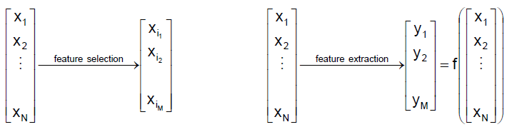
Dimensionality reduction (1)
 Two approaches are available to perform dimensionality reduction
■ Feature extraction: creating a subset of new features by combinations of the existing features
■ Feature selection: choosing a subset of all the features (the ones more informative)

Slide 12
Dimensionality reduction (1)
 The problem of feature extraction can be stated as  Given a feature space x_{i}∈R^{N} find a mapping y=f(x):R^{N}→R^{M} with M<N such that the transformed feature vector y_{i}∈R^{M}
preserves (most of) the information or structure in R^{N}.
■ An optimal mapping y=f(x) will be one that results in no increase in the minimum probability of error
 This is, a Bayes decision rule applied to the initial space R^{N} and to the reduced space R^{M}yield the same classification rate

Slide 13
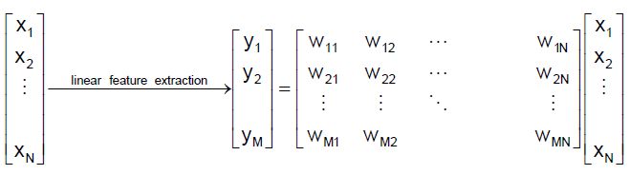
Dimensionality reduction (2)
 In general, the optimal mapping y=f(x) will be a non-linear function
■ However, there is no systematic way to generate non-linear transforms
 The selection of a particular subset of transforms is problem dependent
■ For this reason, feature extraction is commonly limited to linear transforms: y=Wx

Slide 14
Background
Why dimensionality reduction?
What is dimensionality reduction?
Signal representation versus classification

Slide 15
Signal representation versus classification
 The selection of the feature extraction mapping y=f(x) is guided by an objective
function that we seek to maximize (or minimize)
 Depending on the criteria used by the objective function, feature extraction techniques are grouped into two categories:

Slide 16
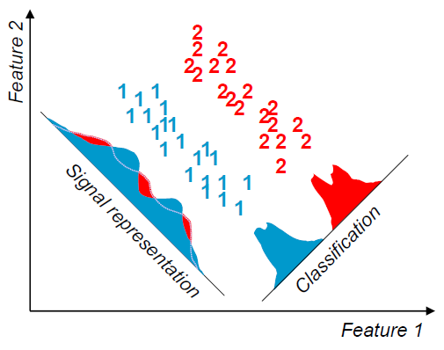
Signal representation versus classification
■ Signal representation: The goal of the feature extraction mapping is to represent the samples
accurately in a lower-dimensional space, minimize the information loss
■ Classification: The goal of the feature extraction mapping is to enhance the class-discriminatory information in the lower-dimensional space

Slide 17
 Within the realm of linear feature extraction, two techniques are commonly used
Signal representation versus classification
■ Principal Components Analysis (PCA)
 uses a signal representation criterion
■ Linear Discriminant Analysis (LDA)
 uses a signal classification criterion

Slide 18
Outline
Background
Unsupervised dimensionality reduction
linear: PCA
nonlinear: GPCA, Kernel PCA, ISOMAP, LLE
Supervised dimensionality reduction
linear: LDA
nonlinear: Kernal LDA
Sparse subspace learning
Summary

Slide 19
 Historical remarks
Principal Components Analysis, PCA
■ Principal Components Analysis is the oldest technique in multivariate analysis
■ PCA is also known as the Karhunen-Loève transform (communication theory)
■ PCA was first introduced by Pearson in 1901, and it experienced several modifications until it was generalized by Loève in 1963

Slide 20
PCA (Principal Components Analysis)
V1: Information (decorrelation + preserve information)
V2: Projection (reconstruction)
V3: Fitting (hyperplane fitting)
Examples
V4: Embedding (distance to coordinate)
V5: Manifold learning (linear manifold)
“Good mathematicians see analogies.
Great mathematicians see analogies between analogies.”
--Stefan Banach

Slide 21
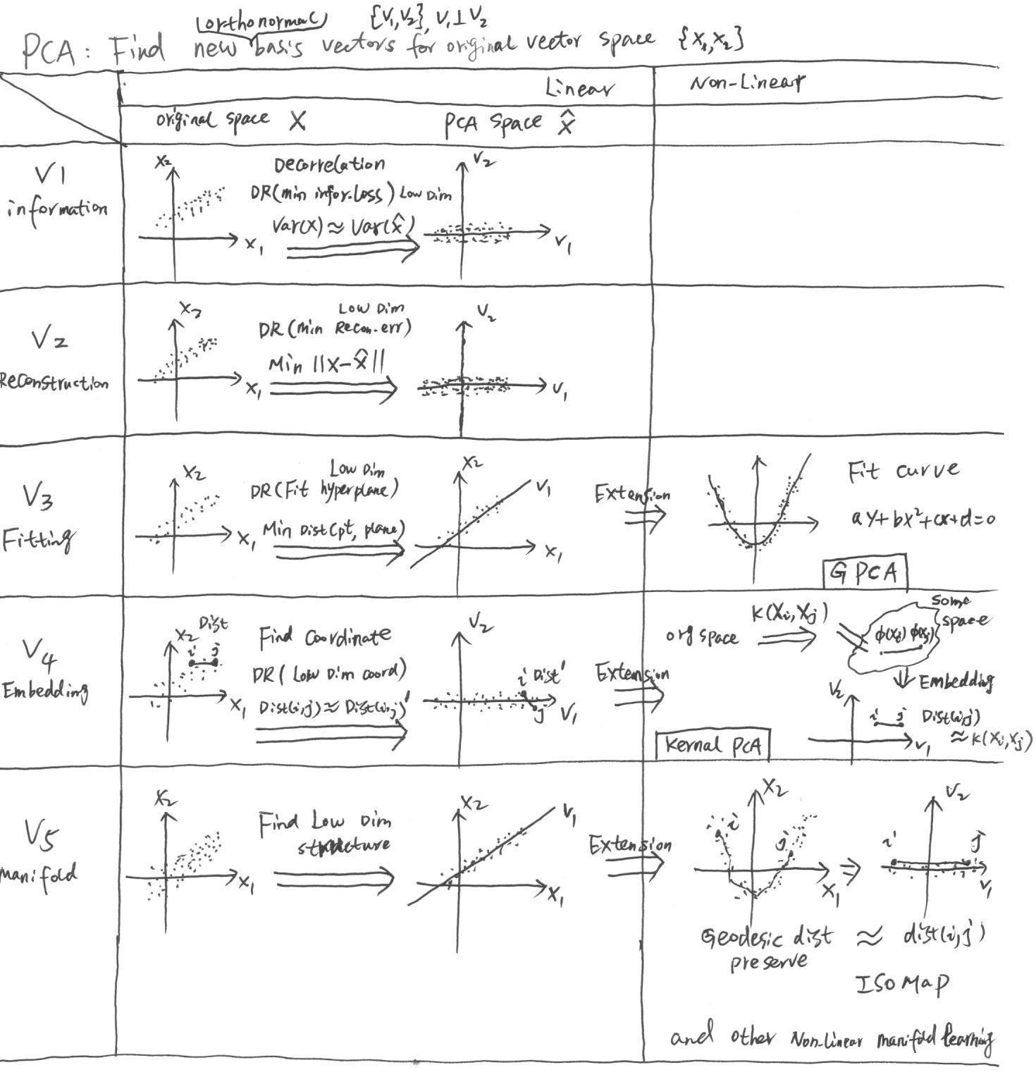

Slide 22
PCA: Decorrelation
We typically have a data matrix of n observations on p correlated dimensions
PCA looks for a linear transformation of the x_{i} into p new dimensions y_{i} that are uncorrelated
Usefull for finding essential factors

Slide 23
PCA: Preserve information
Reduce the dimensionality of a data set by finding a new set of dimensions, smaller than the original set of dimensions
Retains most of the sample's information
Useful for the compression and complexity reduction
What is information? How to measure it?
E.g., Shannon entropy
But we have no pdf, then ?
Try Guassian (Homework)
the variation present in the sample

Slide 24
Algebraic definition of PCs
Given a sample of n observations on a vector of p variables
define the first principal component of the sample
by the linear transformation
where the vector
is chosen such that
is maximum.

Slide 25
Algebraic derivation of PCs
To find first note that
where
is the covariance matrix.

Slide 26
Algebraic derivation of PCs
To find that maximizes subject to
Let λ be a Lagrange multiplier
therefore
is an eigenvector of S
corresponding to the largest eigenvalue

Slide 27
Algebraic derivation of PCs
To find the next coefficient vector maximizing
uncorrelated
subject to
and to
First note that
then let λ and β be Lagrange multipliers, and maximize

Slide 28
Algebraic derivation of PCs

Slide 29
Algebraic derivation of PCs
We find that is also an eigenvector of S
whose eigenvalue is the second largest.
In general
The k^{th} largest eigenvalue of S is the variance of the k^{th} PC.
The k^{th} PC retains the k^{th} greatest fraction of the variation
in the sample.

Slide 30
Algebraic derivation of PCs
Main steps for computing PCs
Form the covariance matrix S.
Compute its eigenvectors:
Use the first d eigenvectors to form the d PCs.
The transformation W is given by

Slide 31
PCA vs. SVD
Assume
Form the matrix:
then
Obtain eigenvectors V of S by computing the SVD of X:

Slide 32
PCA (Principal Components Analysis)
V1: Information (decorrelation + preserve information)
V2: Projection (reconstruction)
V3: Fitting (hyperplane fitting)
Examples
V4: Embedding (distance to coordinate)
V5: Manifold learning (linear manifold)

Slide 34
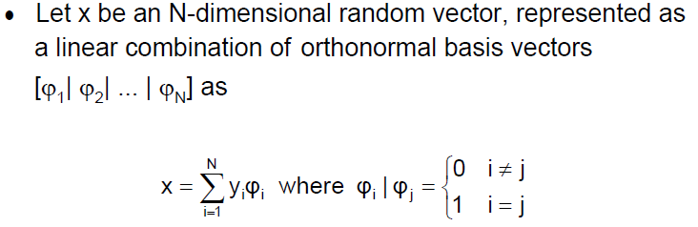
V2: Projection (reconstruction)

Slide 35
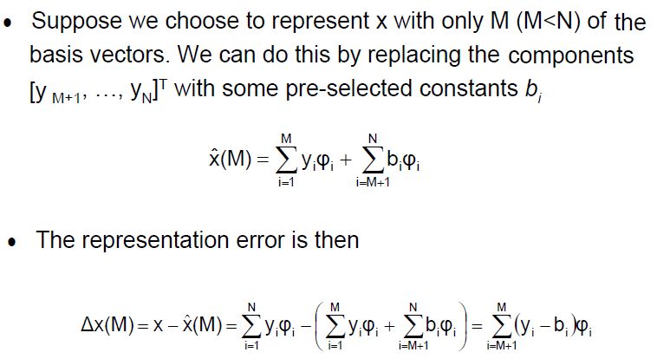
V2: Projection (reconstruction)

Slide 36
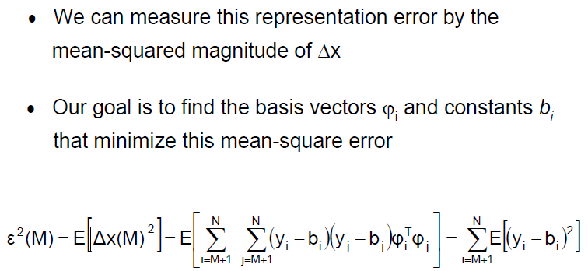
V2: Projection (reconstruction)

Slide 37
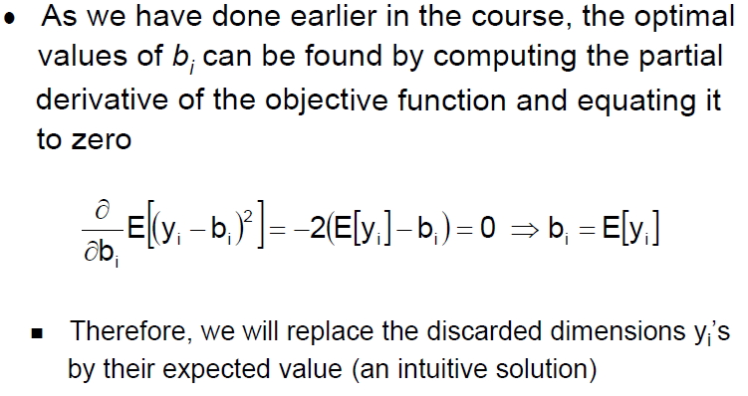
V2: Projection (reconstruction)

Slide 38
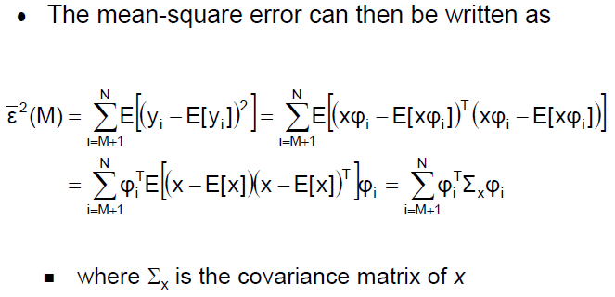
V2: Projection (reconstruction)

Slide 39
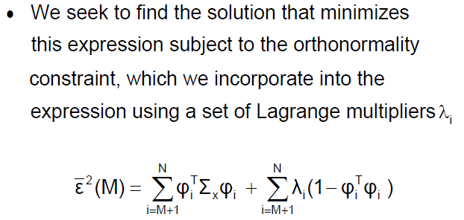
V2: Projection (reconstruction)

Slide 40
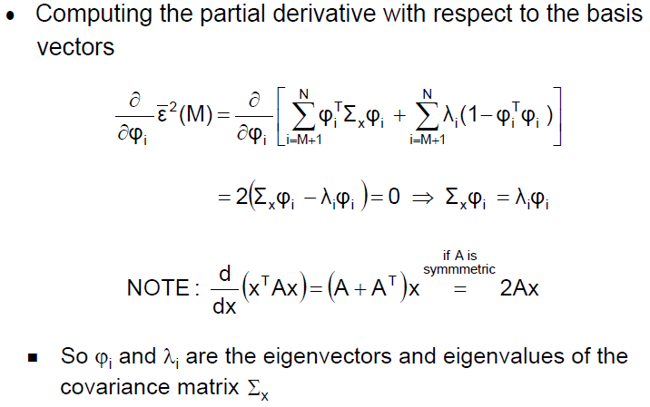
V2: Projection (reconstruction)

Slide 41
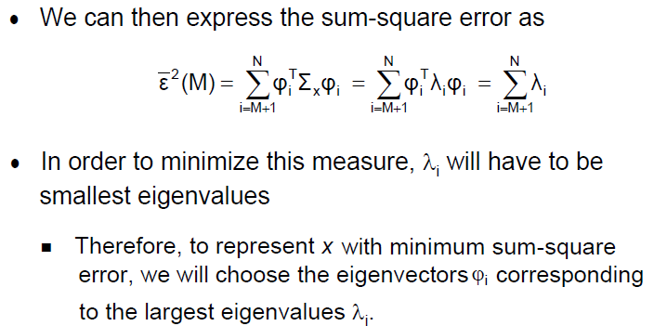
V2: Projection (reconstruction)

Slide 42
PCA (Principal Components Analysis)
V1: Information (decorrelation + preserve information)
V2: Projection (reconstruction)
Algebraic
V3: Fitting (hyperplane fitting)
Geometric
Examples
V4: Embedding (distance to coordinate)
V5: Manifold learning (linear manifold)

Slide 44
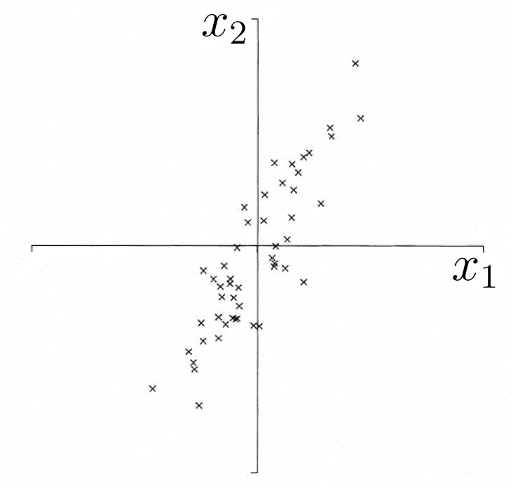
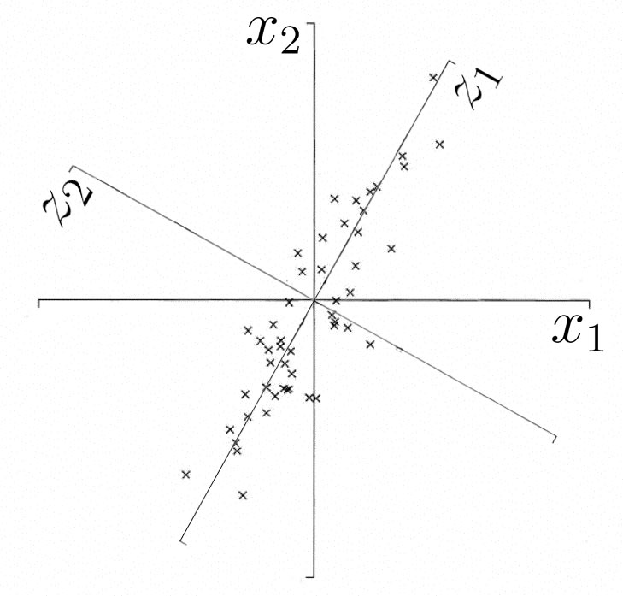
V3: Geometric picture of principal components (PCs)
Homework
V3 Fitting (hyperplane fitting)
the 1st PC is a minimum distance fit to a line in X space
the 2nd PC is a minimum distance fit to a line in the plane perpendicular to the 1st PC
PCs are a series of linear least squares fits to a sample,
each orthogonal to all the previous.

Slide 45
PCA (Principal Components Analysis)
V1: Information (decorrelation + preserve information)
V2: Projection (reconstruction)
V3: Fitting (hyperplane fitting)
Examples
V4: Embedding (distance to coordinate)
V5: Manifold learning (linear manifold)

Slide 46
Examples: Visualization & Modelling

Slide 47
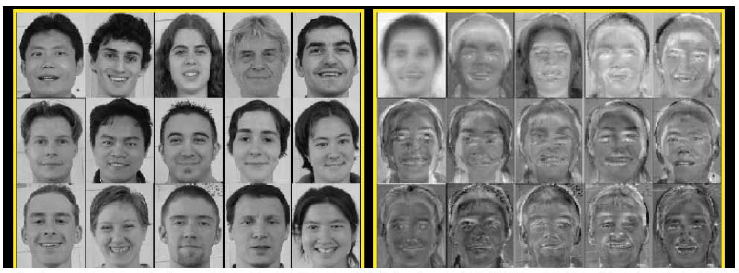
Examples: PCA for face recognition (Eigenfaces)

Slide 48
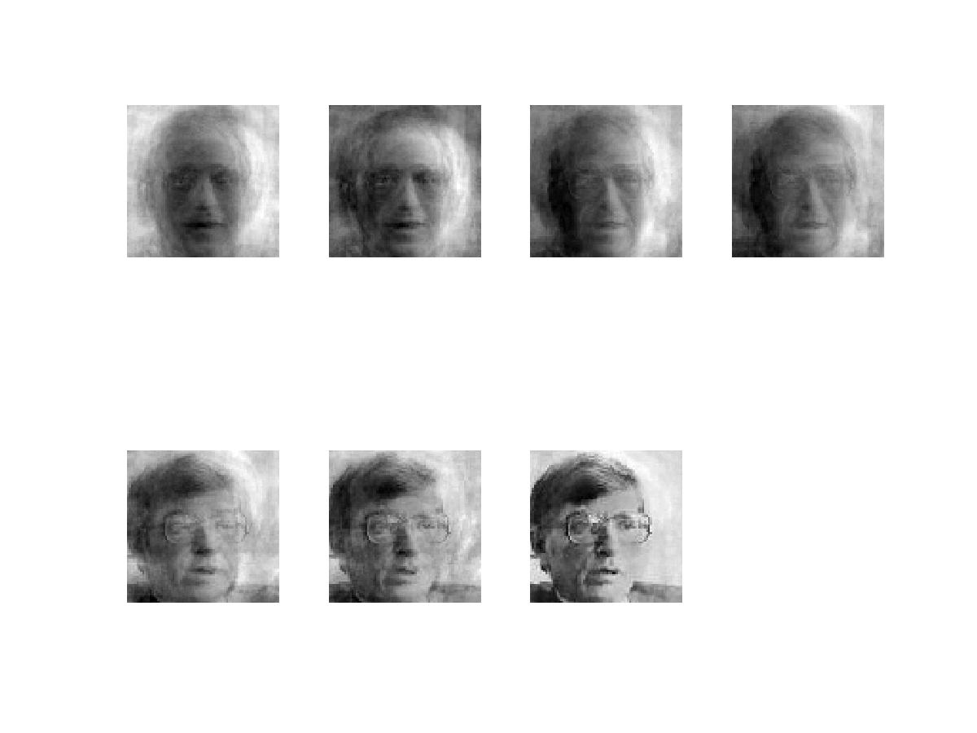
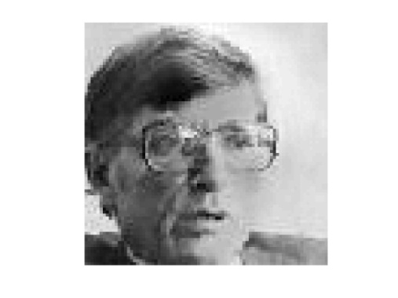
Examples: PCA for image compression
d=1
d=2
d=4
d=8
Original Image
d=16
d=32
d=64
d=100

Slide 49
PCA (Principal Components Analysis)
V1: Information (decorrelation + preserve information)
V2: Projection (reconstruction)
V3: Fitting (hyperplane fitting)
Examples
V4: Embedding (distance to coordinate)
V5: Manifold learning (linear manifold)

Slide 51
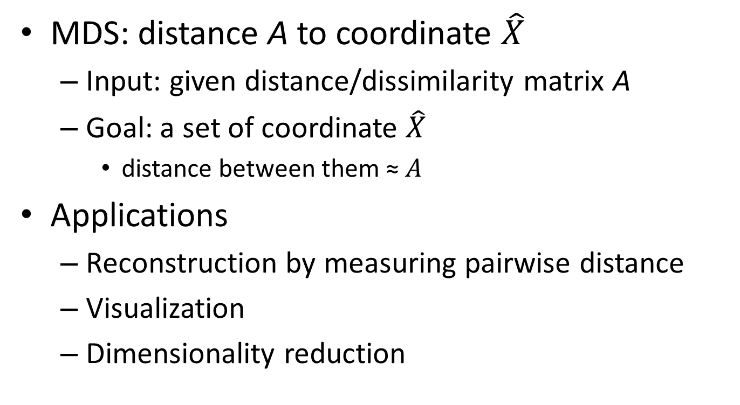
MDS(Multidimensional Scaling): Embedding
MDS: distance A to coordinate $\hat{X}$
Input: given distance/dissimilarity matrix A
Goal: a set of coordinate $\hat{X}$
distance between them ≈ $A$
Applications
Reconstruction by measuring pairwise distance
Visualization
Dimensionality reduction

Slide 52
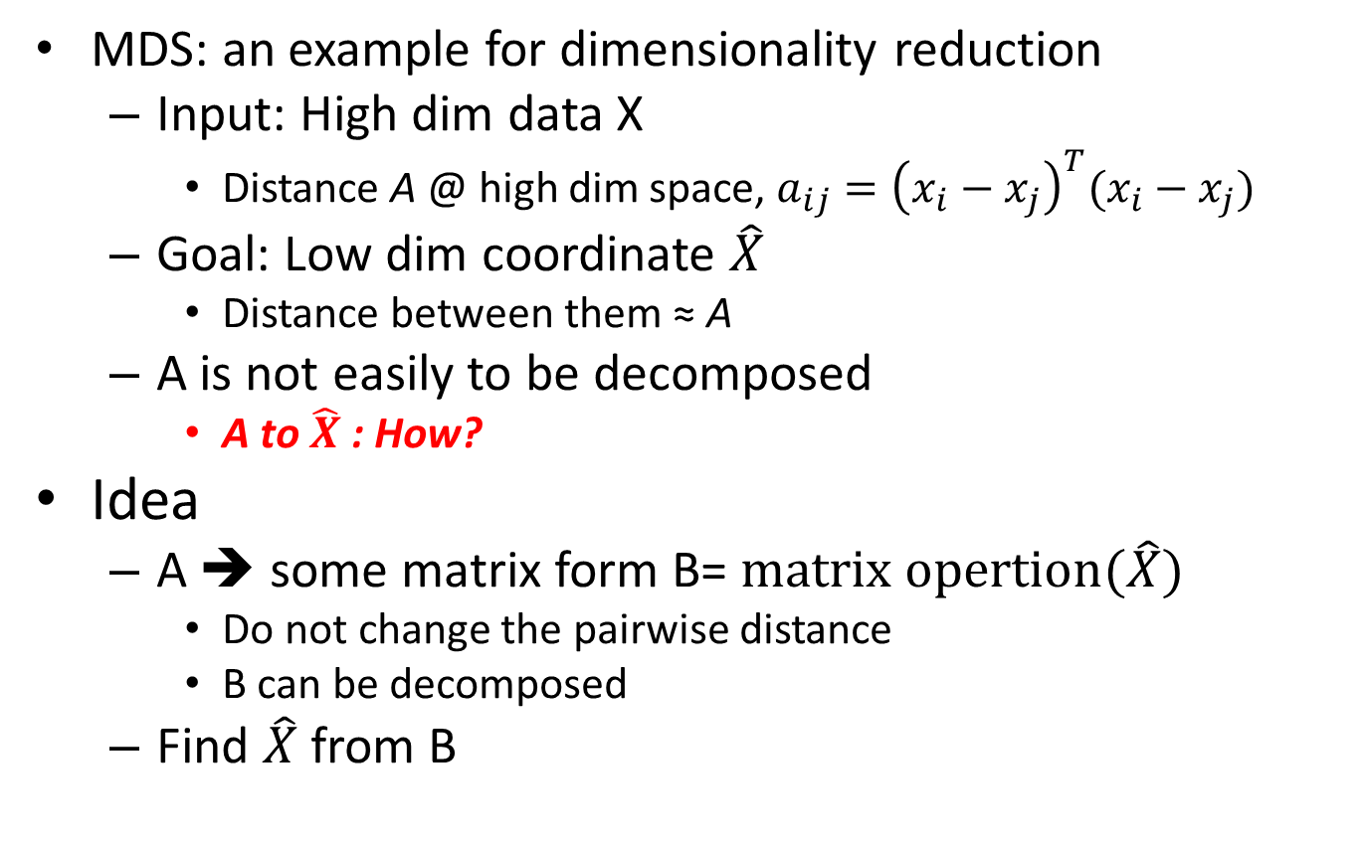
MDS
MDS: an example for dimensionality reduction
Input: High dim data X
Distance A @ high dim space, $a_{ij}={\left(x_{i}−x_{j}\right)}^{T}(x_{i}−x_{j})$
Goal: Low dim coordinate $\hat{X}$
Distance between them ≈ A
A is not easily to be decomposed
A to $\hat{X}$: How?
Idea
A ➔ some matrix form B= $matrix opertion(\hat{X})$
Do not change the pairwise distance
B can be decomposed
Find $\hat{X}$from B

Slide 53
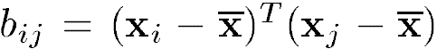
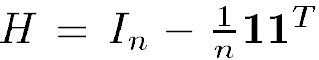
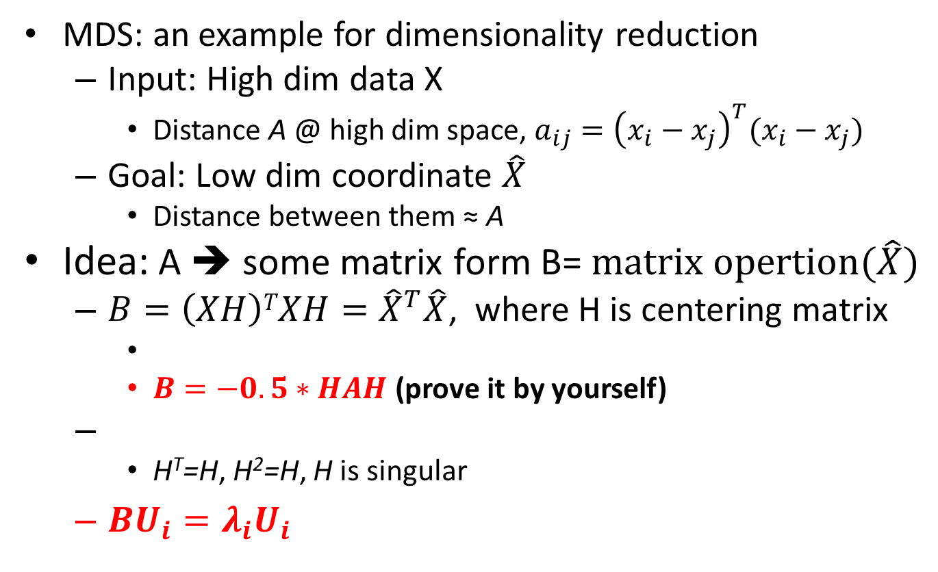
MDS
MDS: an example for dimensionality reduction
Input: High dim data X
Distance A @ high dim space, $a_{ij}={\left(x_{i}−x_{j}\right)}^{T}(x_{i}−x_{j})$
Goal: Low dim coordinate $\hat{X}$
Distance between them ≈ A
Idea: A ➔ some matrix form B= $matrix opertion(\hat{X})$
$B=\left(XH\right)TXH={\hat{X}}^{T}\hat{X}$, where H is centering matrix
$B=−0.5∗HAH$ (prove it by yourself)
H^{T}=H, H²=H, H is singular
$BU_{i}={λ_{i}U}_{i}$

Slide 54
PCA vs. MDS(V4)
If we have the high dim data X_{D} (assume zero mean)
SVD of X_{D}: X_{D}=VDU^{T}
MDS: Low dim coordinate for X_{D}
PCA: new basis vector V
Projection of new sample X’:
PCA to MDS
Projection of X_{D}:
MDS to PCA
Projection of new sample X’

Slide 55
PCA (Principal Components Analysis)
V1: Information (decorrelation + preserve information)
V2: Projection (reconstruction)
V3: Fitting (hyperplane fitting)
Examples
V4: Embedding (distance to coordinate)
V5: Manifold learning (linear manifold)

Slide 57
Geometric picture of principal components (PCs)
V5 Linear manifold
the 1st PC is a minimum distance fit to a line in X space
the 2nd PC is a minimum distance fit to a line in the plane perpendicular to the 1st PC
PCs are a series of linear least squares fits to a sample,
each orthogonal to all the previous.

Slide 58
Outline
Background
Unsupervised dimensionality reduction
linear: PCA
nonlinear: GPCA, Kernel PCA, ISOMAP, LLE
Supervised dimensionality reduction
linear: LDA
nonlinear: Kernal LDA
Sparse subspace learning
Summary

Slide 59
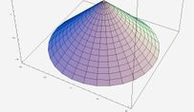
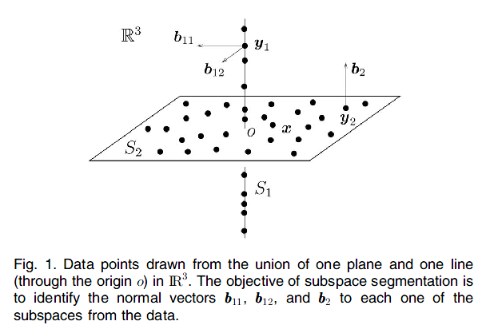
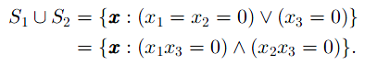
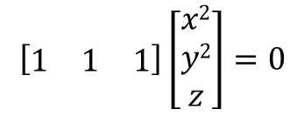
PCA → GPCA
PCA: Fitting (hyperplane fitting)
what if it is hypersurface?
how to represent it?
polynomials: e.g., x²+y²+z=0
GPCA: homogeneous polynomials
$$\left[\begin{matrix}1 & 1 & 1\end{matrix}\right]\left[\begin{matrix}x2 \\ y2 \\ z\end{matrix}\right]=0$$

Slide 60
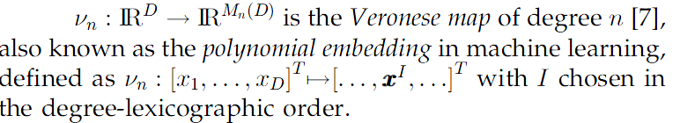
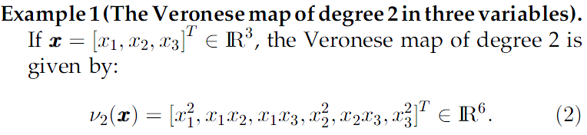
GPCA (Generalized Principal Component Analysis)
sample data space → higher-dim feature space
→ PCA

Slide 61
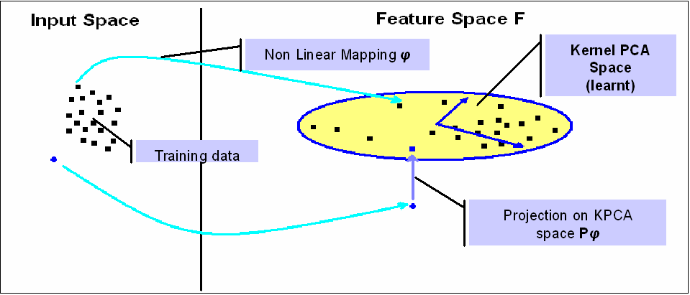
GPCA → Kernel PCA

Slide 62
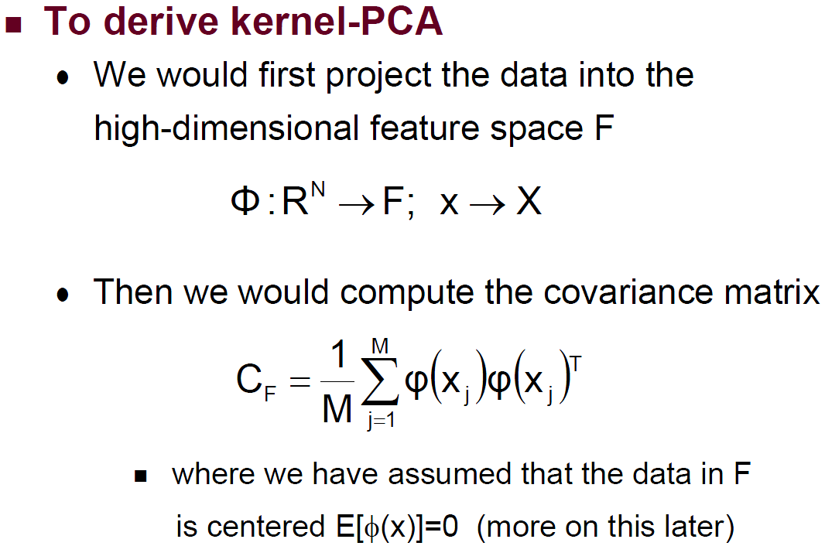
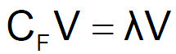
GPCA → Kernel PCA
P
n
C_{F}=ΦΦ^{T}/n
n
But, we do not know what is Φ, it may project data into an infinite dim space
Than how to do it?
Kernel Trick/Dot Trick (XX^{T}→X^{T}X)

Slide 63
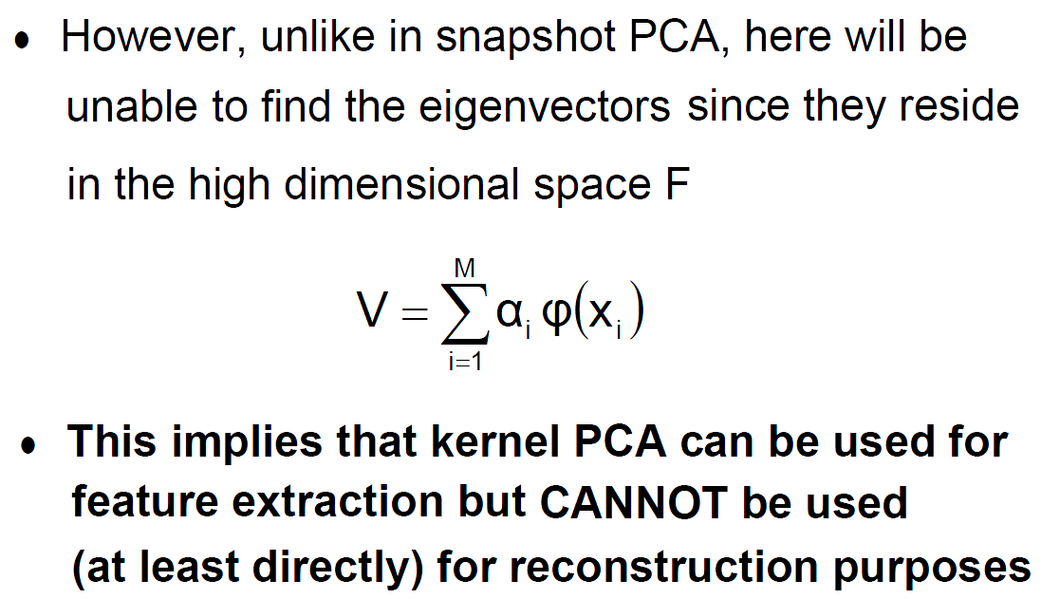



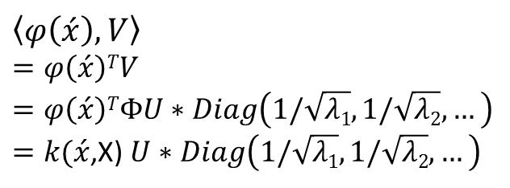

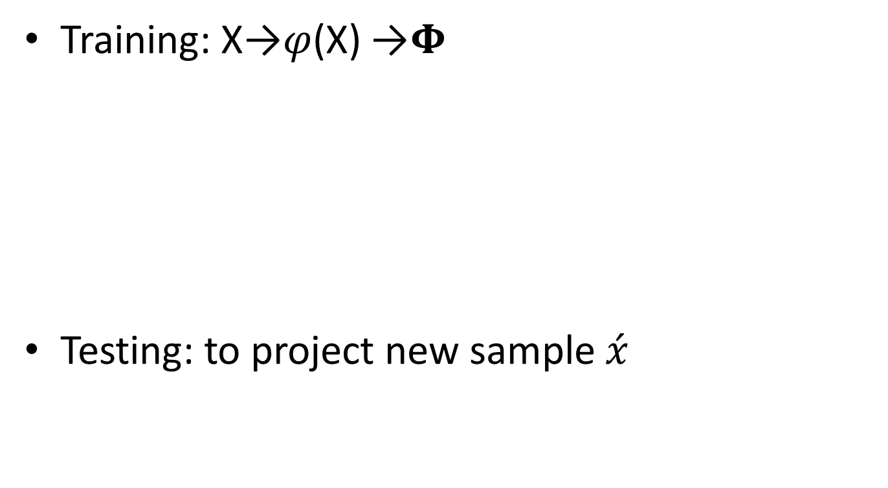



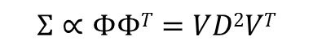

Kernel PCA: MDS on the Kernel
Training: X→$φ$(X) →$Φ$
Testing: to project new sample $\acute{x}$
$$Φ=VDU^{T}$$
Original problem
$$Σ∝ΦΦT=VD2VT$$
$$ΣV=λV$$
$$V$$
Kernel trick
Recall that: MDS vs. PCA
Dot product
$$K=ΦTΦ=UD2UT$$
$$Kij=k\left(x_{i}, x_{j}\right)=\left\langle φ\left(xi\right),φ\left(xj\right)\right\rangle$$
$$KU=λU$$
$$U$$
$$V$$
$$V=ΦUD^{−1}=ΦU∗Diag(1/\sqrt{λ1},1/\sqrt{λ2},…)$$
But we can not get the actual value of V
$$\left\langle φ\left(\acute{x}\right),V\right\rangle$$
$$=φ\left(\acute{x}\right)TV$$
$$=φ\left(\acute{x}\right)TΦU∗Diag\left(1/\sqrt{λ1},1/\sqrt{λ2},…\right)$$
$=k(\acute{x}$,X) $U∗Diag\left(1/\sqrt{λ1},1/\sqrt{λ2},…\right)$
We can only get the projection on V

Slide 64
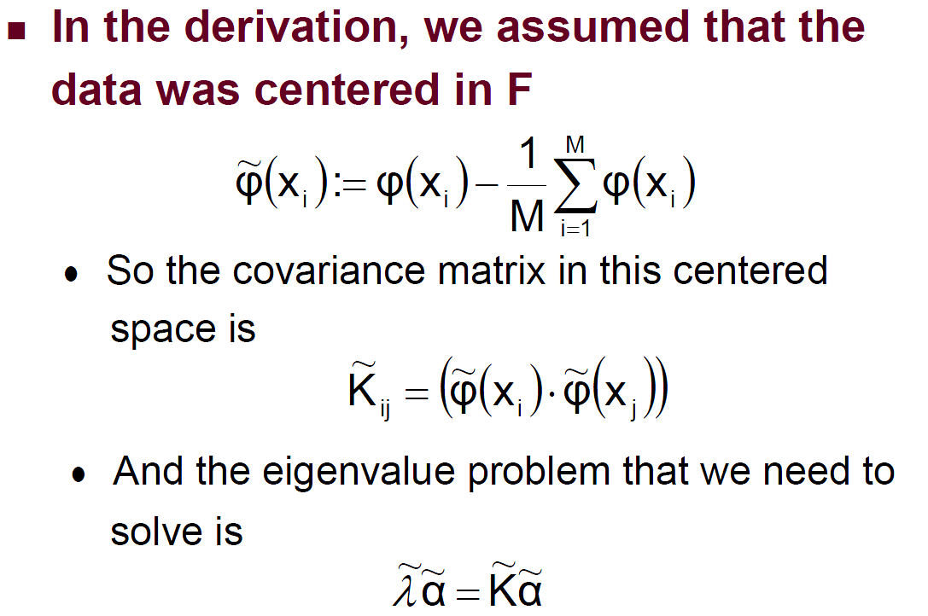
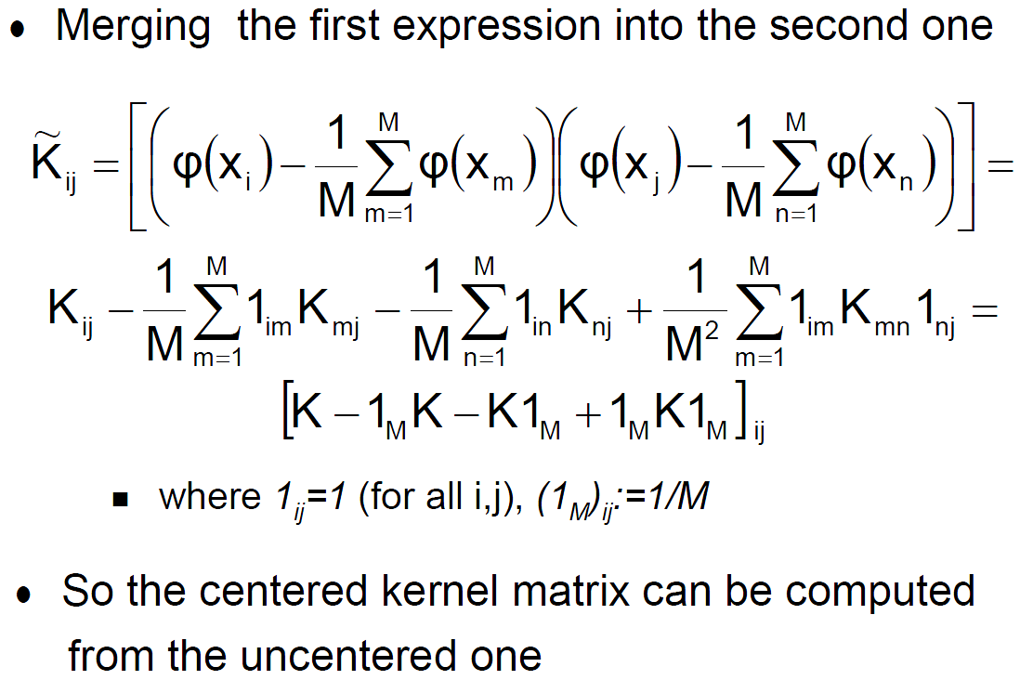
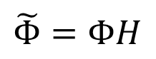
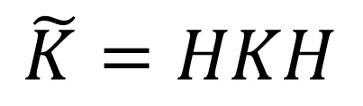
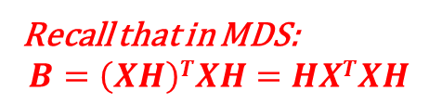
Kernel PCA: normalization
$$\tilde{Φ}=ΦH$$
kernel
Recall that in MDS:
$$B=\left(XH\right)TXH=HXTXH$$
$$\tilde{K}=HKH$$
$$V=ΦHUD^{−1}=ΦHU∗Diag(1/\sqrt{λ1},1/\sqrt{λ2},…)$$

Slide 65
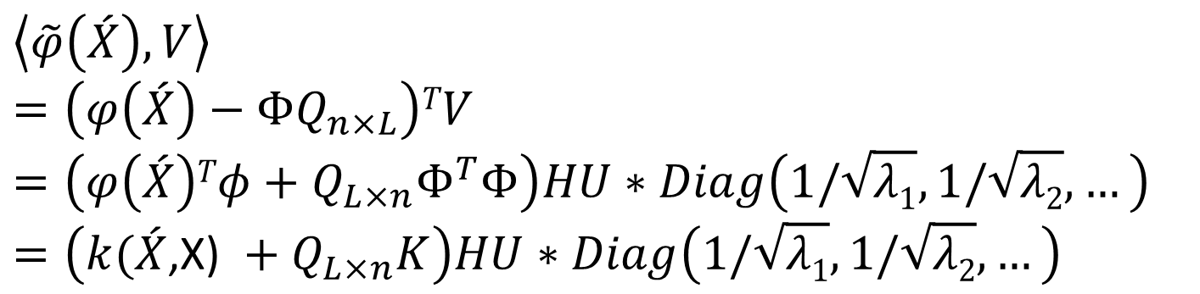
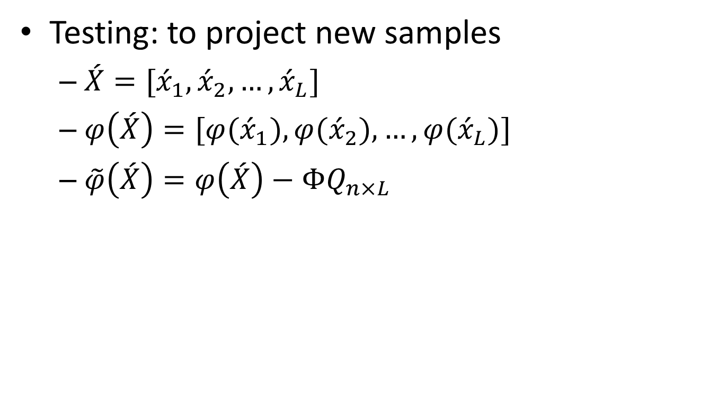
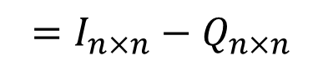
Kernel PCA: normalization
Testing: to project new samples
$\acute{X}=[{\acute{x}}_{1},{\acute{x}}_{2},…,{\acute{x}}_{L}]$
$φ\left(\acute{X}\right)=[φ({\acute{x}}_{1}),φ({\acute{x}}_{2}),…,φ({\acute{x}}_{L})]$
$\tilde{φ}\left(\acute{X}\right)=φ\left(\acute{X}\right)−ΦQ_{n×L}$
$$=I_{n×n}−Q_{n×n}$$
$$\left\langle \tilde{φ}\left(\acute{X}\right),V\right\rangle$$
$$=\left(φ\left(\acute{X}\right)−ΦQ_{n×L}\right)TV$$
$$=\left(φ\left(\acute{X}\right)Tφ+Q_{L×n}Φ^{T}Φ\right)HU∗Diag\left(1/\sqrt{λ1},1/\sqrt{λ2},…\right)$$
$$=\left(k(\acute{X}\text{,}\text{X}\text{) }+Q_{L×n}K\right)HU∗Diag\left(1/\sqrt{λ1},1/\sqrt{λ2},…\right)$$

Slide 66
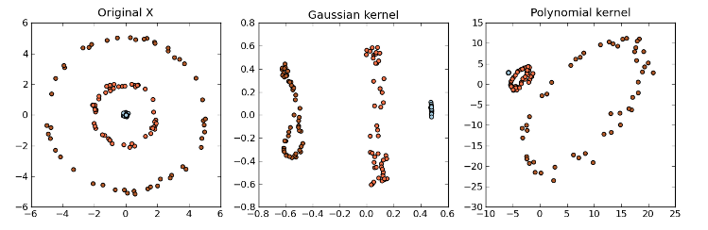
Kernel PCA: example # 1

Slide 67
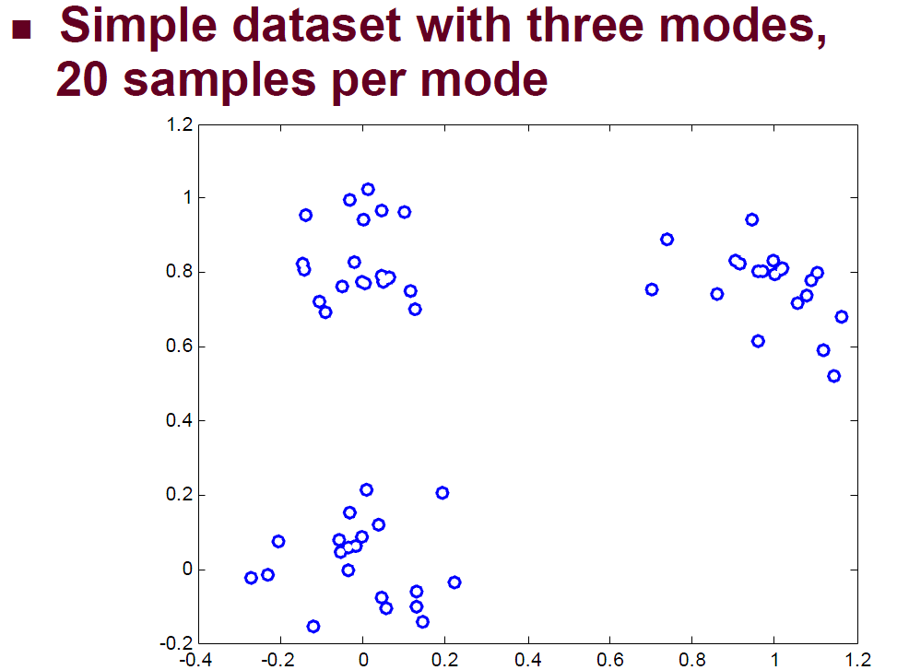
Kernel PCA: example #2

Slide 68
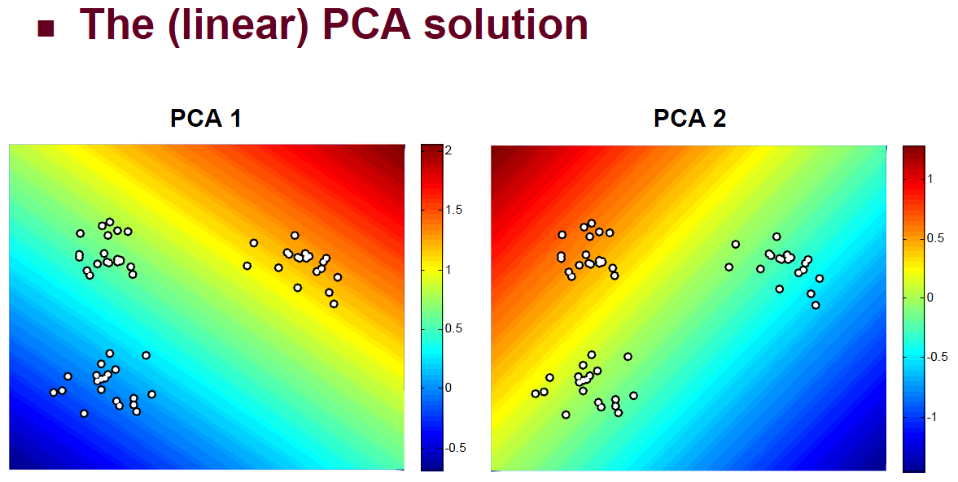
Kernel PCA: example #2

Slide 69
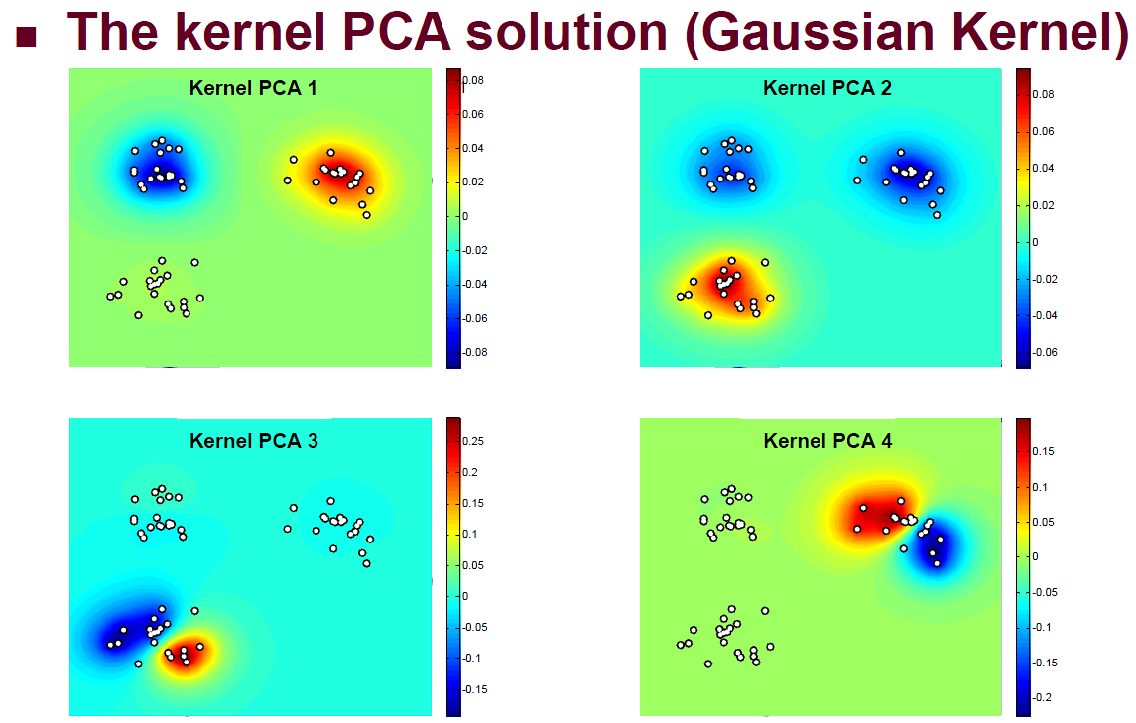
Kernel PCA: example #2

Slide 70
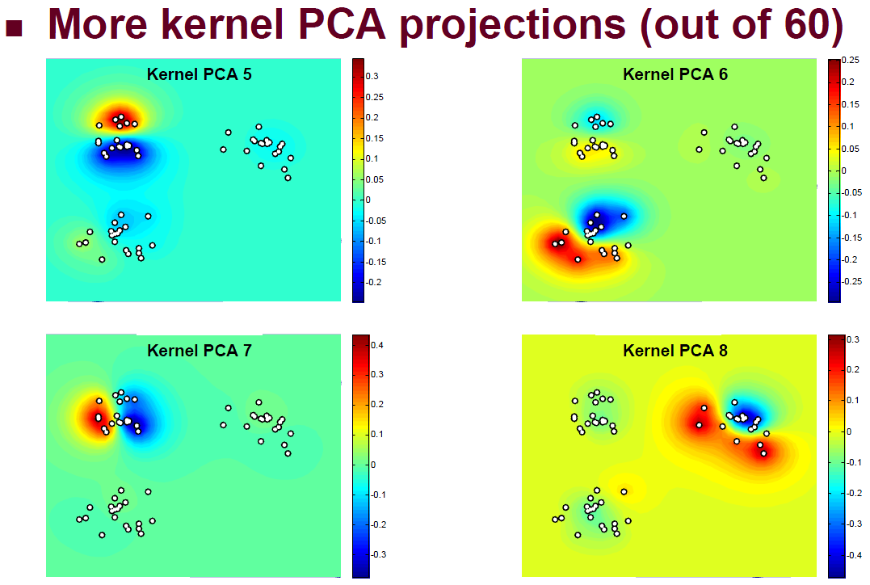
Kernel PCA: example

Slide 71
Outline
Background
Unsupervised dimensionality reduction
linear: PCA
nonlinear: GPCA, Kernel PCA, ISOMAP, LLE
Supervised dimensionality reduction
linear: LDA
nonlinear: Kernal LDA
Sparse subspace learning
Summary

Slide 72
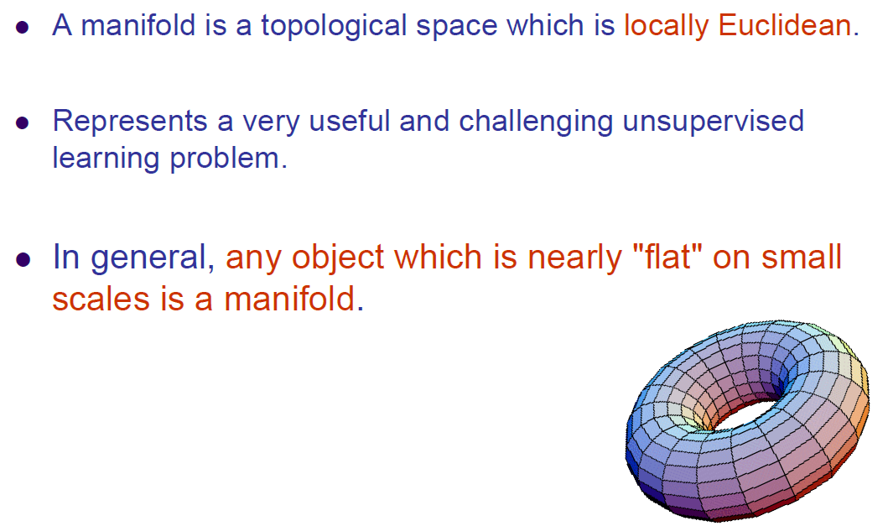
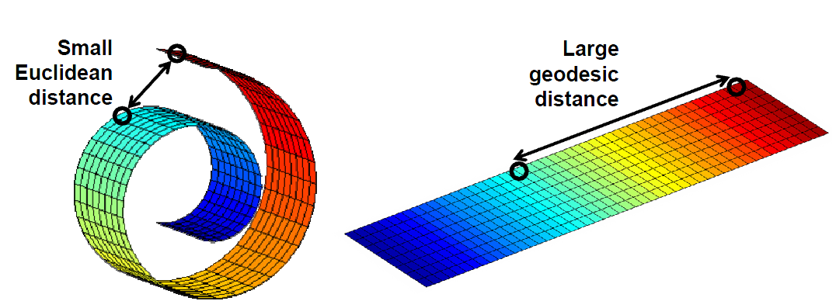
Manifold

Slide 73


Manifold learning

Slide 74


ISOMAP

Slide 75

ISOMAP

Slide 76

ISOMAP

Slide 77
Outline
Background
Unsupervised dimensionality reduction
linear: PCA
nonlinear: GPCA, Kernel PCA, ISOMAP, LLE
Supervised dimensionality reduction
linear: LDA
nonlinear: Kernal LDA
Sparse subspace learning
Summary

Slide 78

LLE (Locally Linear Embedding) Fit locally, Think Globally

Slide 79

LLE

Slide 80

Comparison

Slide 81
Outline
Background
Unsupervised dimensionality reduction
linear: PCA
nonlinear: GPCA, Kernel PCA, ISOMAP, LLE
Supervised dimensionality reduction
linear: LDA
nonlinear: Kernal LDA
Sparse subspace learning
Summary

Slide 82
Signal representation versus classification

Slide 83
LDA
LDA part: PRML02_LDA.pdf
Kernel LDA part: PRML02_Kernel_LDA.pdf

Slide 84
Outline
Background
Unsupervised dimensionality reduction
linear: PCA
nonlinear: GPCA, Kernel PCA, ISOMAP, LLE
Supervised dimensionality reduction
linear: LDA
nonlinear: Kernal LDA
Sparse subspace learning
Summary

Slide 85
sample data space
feature space
maximize
discrimination
minimize
infomation loss
hypersurface fitting
known mapping
PCA
Fitting
GPCA
Embedding
LDA
Manifold
KernelPCA
unknown mapping
Manifold learning
Embedding
Preserve
Euclidean distance/other
Preserve
neighbourhood relationship
MDS
LLE
Kernel
LDA
Preserve
geodesic distance
Full subspace
Partial subspace used
ISOMAP
Sparse
Subspace

